Slide 1
Elaboration

Slide 2
The requirements for the first iteration of the NextGen POS application
Implement a basic, key scenario of the Process Sale use case: entering items and receiving a cash payment.
Implement a Start Up use case as necessary to support the initialization needs of the iteration.
Nothing fancy or complex is handled, just a simple happy path scenario, and the design and implementation to support it.
There is no collaboration with external services, such as a tax calculator or product database.
No complex pricing rules are applied.

Slide 3
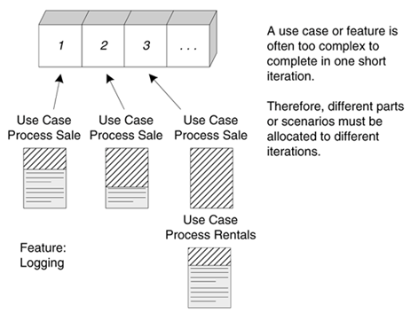
Use case implementation may be spread across iterations

Slide 4
On to Elaboration
the core, risky software architecture is programmed and tested
the majority of requirements are discovered and stabilized
the major risks are mitigated or retired
Build the core architecture, resolve the high-risk elements, define most requirements, and estimate the overall schedule and resources.

Slide 5
What Artifacts May Start in Elaboration?
Artifact | Comment
Domain Model | This is a visualization of the domain concepts; it is similar to a static information model of the domain entities.
Design Model | This is the set of diagrams that describes the logical design. This includes software class diagrams, object interaction diagrams, package diagrams, and so forth.
Software Architecture Document | A learning aid that summarizes the key architectural issues and their resolution in the design. It is a summary of the outstanding design ideas and their motivation in the system.
Data Model | This includes the database schemas, and the mapping strategies between object and non-object representations.
Use-Case Storyboards, UI Prototypes | A description of the user interface, paths of navigation, usability models, and so forth.

Slide 6
Planning the Next Iteration
Risk
  includes both technical complexity and other factors, such as uncertainty of effort or usability.
Coverage
  implies that all major parts of the system are at least touched on in early iterations perhaps a "wide and shallow" implementation across many components.
Criticality
  refers to functions the client considers of high business value.

Slide 7
Rank | Requirement (Use Case or Feature) | Comment
High | Process Sale Logging … | Scores high on all rankings. Pervasive. Hard to add late. …
Medium | Maintain Users … | Affects security subdomain. …
Low | … | …

Slide 8
Alan Modeli
(Domain Model)

Slide 9
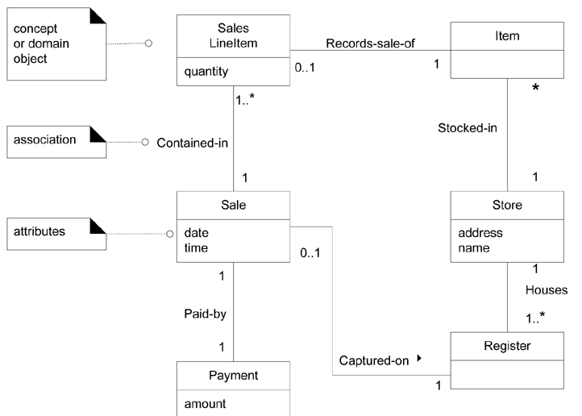
A Sample Domain Model

Slide 10
The Elements of Domain Model
Domain objects or conceptual classes
Associations between conceptual classes
Attributes of conceptual classes

Slide 11

Domain model shows real-situation conceptual classes, not software classes

Slide 12
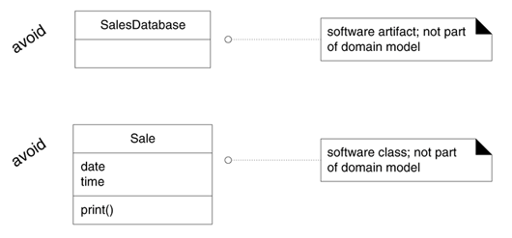
A domain model does not show software artifacts or classes

Slide 13
What are Conceptual Classes?
Symbol words or images representing a conceptual class.
Intension the definition of a conceptual class.
Extension the set of examples to which the conceptual class applies.

Slide 14
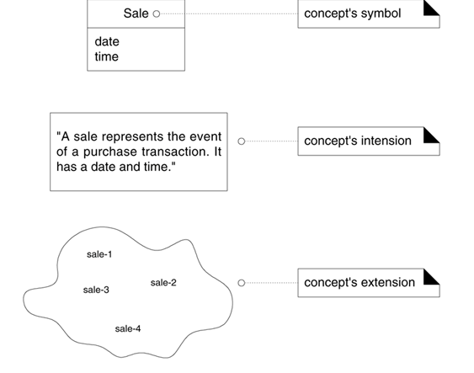
A conceptual class has a symbol, intension, and extension

Slide 15
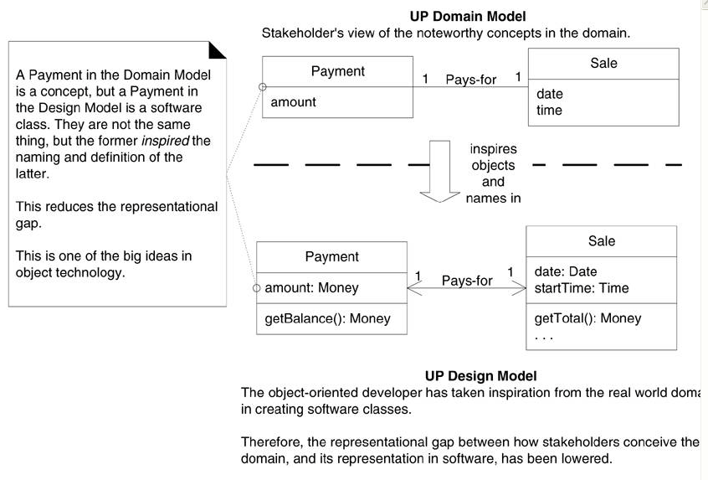
Lower representational gap with OO modeling

Slide 16
How to Create a Domain Model?
Find the conceptual classes
Draw them as classes in a UML class diagram.
Add associations and attributes.

Slide 17
Three Strategies to Find Conceptual Classes
Reuse or modify existing models.
Use a category list.
Identify noun phrases.

Slide 18
Conceptual Class Category List
Conceptual Class Category | Examples
business transactions Guideline: These are critical (they involve money), so start with transactions. | Sale, Payment Reservation
transaction line items Guideline: Transactions often come with related line items, so consider these next. | SalesLineItem
product or service related to a transaction or transaction line item Guideline: Transactions are for something (a product or service). Consider these next. | Item Flight, Seat, Meal
where is the transaction recorded? Guideline: Important. | Register, Ledger FlightManifest

Slide 19
roles of people or organizations related to the transaction; actors in the use case Guideline: We usually need to know about the parties involved in a transaction. | Cashier, Customer, Store MonopolyPlayer Passenger, Airline
place of transaction; place of service | Store Airport, Plane, Seat
noteworthy events, often with a time or place we need to remember | Sale, Payment MonopolyGame Flight
physical objects Guideline: This is especially relevant when creating device-control software, or simulations. | Item, Register Board, Piece, Die Airplane
descriptions of things | ProductDescription FlightDescription

Slide 20
Catalogs Guideline: Descriptions are often in a catalog. | ProductCatalog FlightCatalog
containers of things (physical or information) | Store, Bin Board Airplane
things in a container | Item Square (in a Board) Passenger
other collaborating systems | CreditAuthorizationSystem AirTrafficControl
records of finance, work, contracts, legal matters | Receipt, Ledger MaintenanceLog
financial instruments | Cash, Check, LineOfCredit TicketCredit
schedules, manuals, documents that are regularly referred to in order to perform work | DailyPriceChangeList RepairSchedule

Slide 21
Finding Conceptual Classes with Noun Phrase Identification -1
1. Customer arrives at a POS checkout with goods and/or services to purchase.
2. Cashier starts a new sale.
3. Cashier enters item identifier.
4. System records sale line item and presents item description, price, and running total. Price calculated from a set of price rules.
Cashier repeats steps 2-3 until indicates done.
5. System presents total with taxes calculated.

Slide 22
Finding Conceptual Classes with Noun Phrase Identification -2
6. Cashier tells Customer the total, and asks for payment.
7. Customer pays and System handles payment.
8. System logs the completed sale and sends sale and payment information to the external Accounting (for accounting and commissions) and Inventory systems (to update inventory).
9. System presents receipt.
10. Customer leaves with receipt and goods (if any).

Slide 23
Concepts in the POS Domain
Sale | Cashier
CashPayment | Customer
SalesLineItem | Store
Item | ProductDescription
Register | ProductCatalog
Ledger

Slide 24
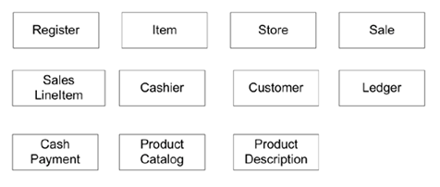
Initial POS domain model

Slide 25


Attributes vs. Classes
If we do not think of some conceptual class X as a number or text
in the real world, X is probably a conceptual class, not an attribute.

Slide 26
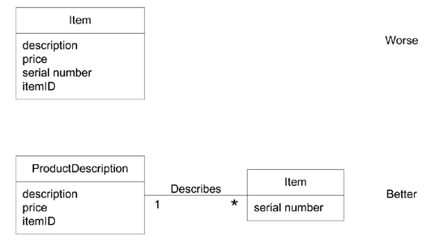
Why Use 'Description' Classes?

Slide 27
When Are Description Classes Useful?
There needs to be a description about an item or service, independent of the current existence of any examples of those items or services.
Deleting instances of things they describe (for example, Item) results in a loss of information that needs to be maintained, but was incorrectly associated with the deleted thing.
It reduces redundant or duplicated information.

Slide 28
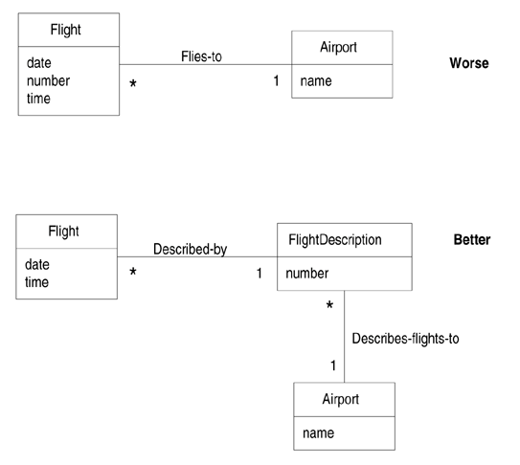
Descriptions about other things

Slide 29
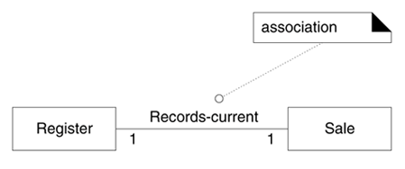
Associations

Slide 30
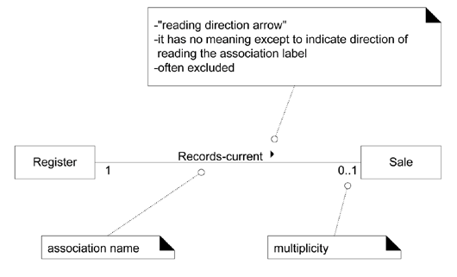
The UML notation for associations

Slide 31
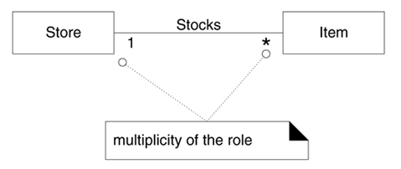
Multiplicity on an association

Slide 32
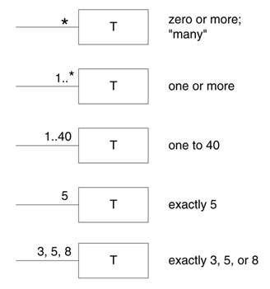
Multiplicity values

Slide 33
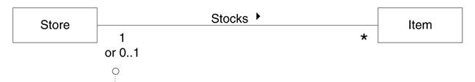
Multiplicity is context dependent

Slide 34
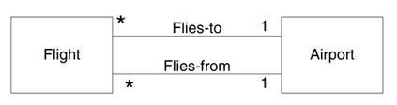
Multiple associations

Slide 35
Common Associations List
Category | Examples
A is a transaction related to another transaction B | CashPaymentSale CancellationReservation
A is a line item of a transaction B | SalesLineItemSale
A is a product or service for a transaction (or line item) B | ItemSalesLineItem (or Sale) FlightReservation
A is a role related to a transaction B | CustomerPayment PassengerTicket
A is a physical or logical part of B | DrawerRegister SquareBoard SeatAirplane
A is physically or logically contained in/on B | RegisterStore, ItemShelf SquareBoard PassengerAirplane

Slide 36
A is a description for B | ProductDescriptionItem FlightDescriptionFlight
A is known/logged/recorded/reported/captured in B | SaleRegister PieceSquare ReservationFlightManifest
A is a member of B | CashierStore PlayerMonopolyGame PilotAirline

Slide 37
A is an organizational subunit of B | DepartmentStore MaintenanceAirline
A uses or manages or owns B | CashierRegister PlayerPiece PilotAirplane
A is next to B | SalesLineItemSalesLineItem SquareSquare CityCity

Slide 38
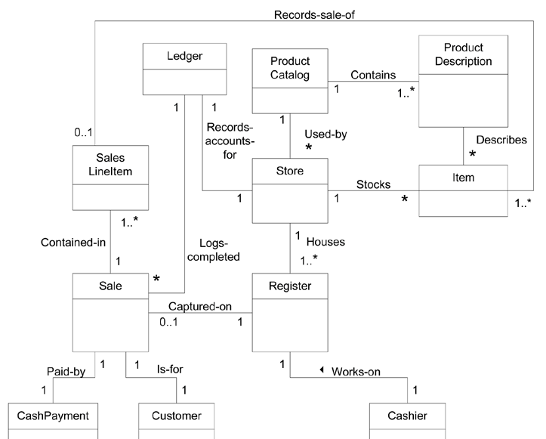

Slide 39
When to Show Attributes?
A receipt in the Process Sale use case normally includes a date and time, the store name and address, and the cashier ID, among many other things.
Sale needs a dateTime attribute.
Store needs a name and address.
Cashier needs an ID.

Slide 40
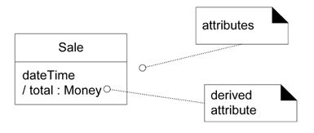
Class and attributes

Slide 41
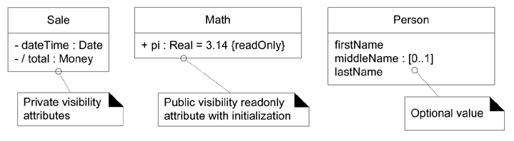
Attribute notation in UML

Slide 42
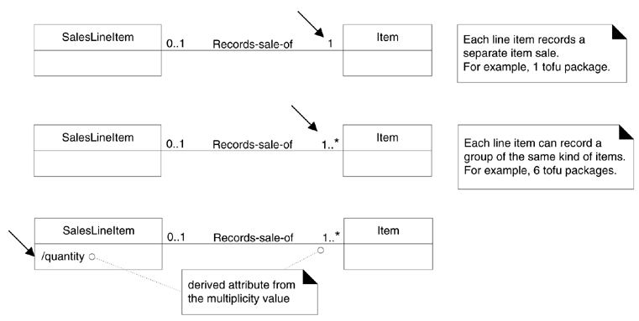

Slide 43
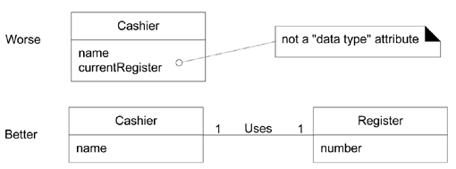
Relate with associations, not attributes

Slide 44
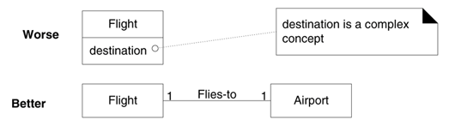
Don't show complex concepts as attributes; use associations

Slide 45
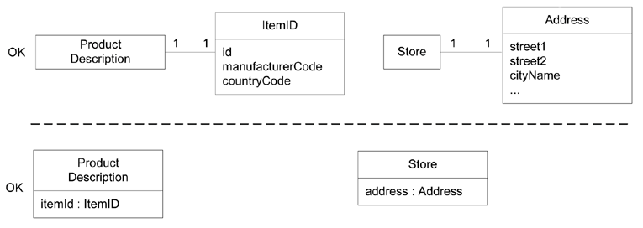
Two ways to indicate a data type property of an object

Slide 46
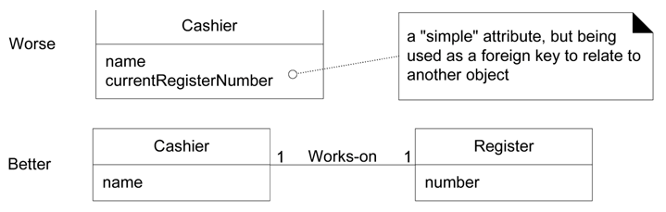
No Attributes Representing Foreign Keys

Slide 47
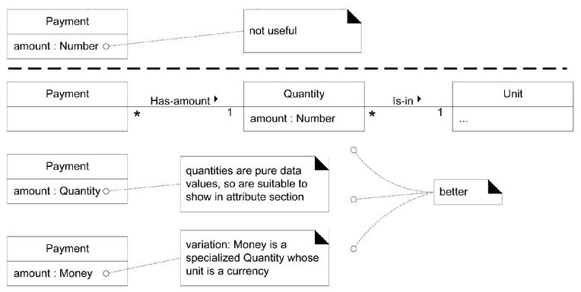
Modeling Quantities and Units

Slide 48
Attributes in the Domain Models of NextGen POS
CashPayment | amountTendered To determine if sufficient payment was provided, and to calculate change, an amount (also known as "amount tendered") must be captured.
Product-Description | description To show the description on a display or receipt. itemId To look up a ProductDescription. price To calculate the sales total, and show the line item price.
Sale | dateTime A receipt normally shows date and time of sale, and this is useful for sales analysis.
SalesLineItem | quantity To record the quantity entered, when there is more than one item in a line item sale (for example, five packages of tofu).
Store | address, name The receipt requires the name and address of the store.

Slide 49
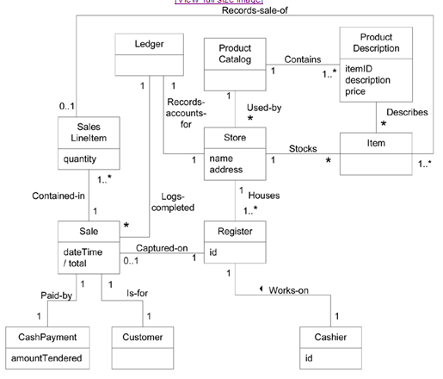

Slide 50
Domain Models Within the UP
Discipline | Artifact | Incep. | Elab. | Const. | Trans.
 | Iteration | I1 | E1..En | C1..Cn | T1..T2
Business Modeling | Domain Model |  | s
Requirements | Use-Case Model (SSDs) | s | r
 | Vision | s | r
 | Supplementary Specification | s | r
 | Glossary | s | r
Design | Design Model |  | s | r
 | SW Architecture Document |  | s
 | Data Model |  | s | r

